Slide 1

Toronto Crime Analysis
Presented By:
Adam Tour
Aditya Parmar
Bowen Pang (Jasper)
Gurpreet Singh Dhameja
Instructor: Madhur Chopra

Slide 2

Agenda
How Can I know which place is safer?
How should I locate the neighborhood?
How can I compare top 5 safe and unsafe neighborhood?

Slide 3
Agenda
TORONTO CRIME ANALYSIS
How Can I know which place is safer?
How should I locate the neighborhood?
How can I compare top 5 safe and unsafe neighborhood?
3
3

Slide 4

Introduction
This project examines different categories for crime data for each of the 158 neighborhoods in Toronto.
The goal of our project is to help the population visualize crime trends in their neighborhood. Our dashboard displays interactive charts that show how a particular type of crime occurrence has changed over a range of years, the distribution of crimes in a given neighborhood, and how that neighborhood ranks among all neighborhoods based on the chosen crime.

Slide 5
Introduction
This project examines different categories for crime data for each of the 158 neighborhoods in Toronto.
The goal of our project is to help the population visualize crime trends in their neighborhood. Our dashboard displays interactive charts that show how a particular type of crime occurrence has changed over a range of years, the distribution of crimes in a given neighborhood, and how that neighborhood ranks among all neighborhoods based on the chosen crime.
5

Slide 6
Process and Decision Making
Brainstorm ideas
Finalizing Topic
Data collection
Task allocation
Data cleaning
Observation
Consolidate contributions
Adding New Library in JS
Final Review

Slide 7
Data Cleaning and Limitations
TORONTO CRIME ANALYSIS
Data Cleaning
Data resource: Toronto Police Service Data Portal
Merged and reorganized
!
Limitations
Unavailable dataset and missing information in the raw dataset
Different Column Names & Date Format
7

Slide 8
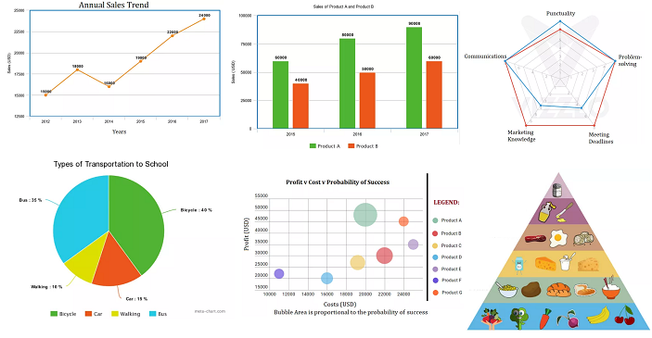
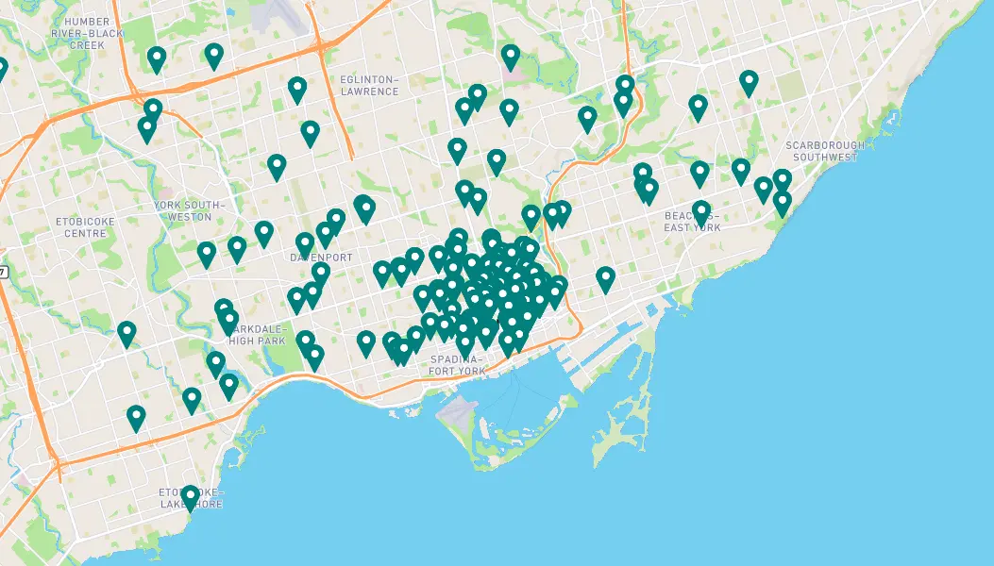
Graphs & Map
This project includes:
Graphs:
Line Chart
Radial Chart
Bar Chart
Map:
Markers with crime details
TORONTO CRIME ANALYSIS
8

Slide 9
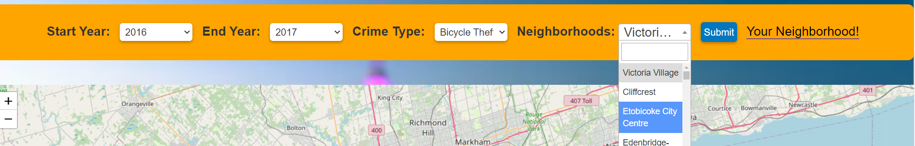
NEW Library added
Select2 is a popular JavaScript library that enhances the functionality of a standard HTML select element. It provides a user-friendly interface for selecting one or more options from a long list of items. Select2 is built on top of jQuery and is widely used in web applications to improve the user experience of dropdowns.

Slide 10
Summary
Analyzing the crime data from the Toronto Police Service.
Includes most of the information like type of crime, location ,time and other relevant details.
Most of the dangerous neighborhood are in downtown, but Yonge and St. Clair is considered one of the safest neighborhood.
We took the average of the latitude and longitude of each neighborhood in order to mark symbol on the map.
We used average number of crimes of each year to investigate the seasonality.

Slide 11
Thank you

